Slide 1
Fundamentals of Computer & Computing
By Mala Rani Barman
Lecturer
Dept. of CSE

Slide 2
Chapter 01
Ryklnrtjpojpoj
Ihtioreyio
iyreipi

Slide 3
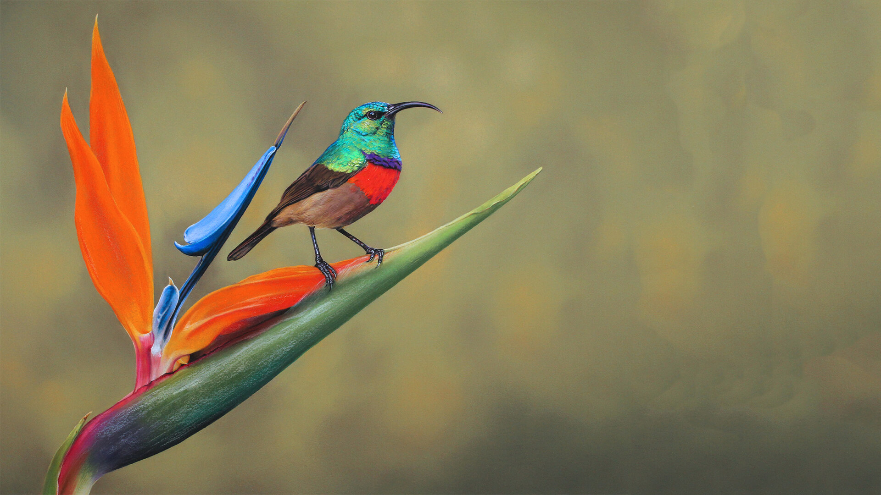

Slide 5


